Slide 1
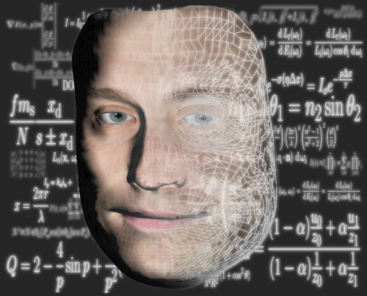

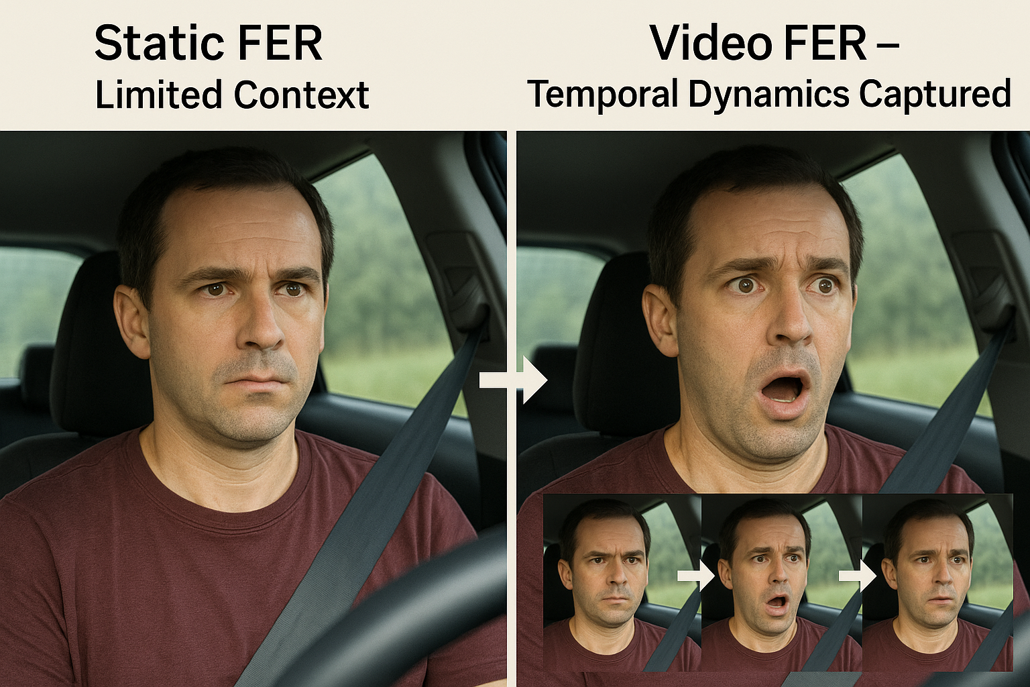
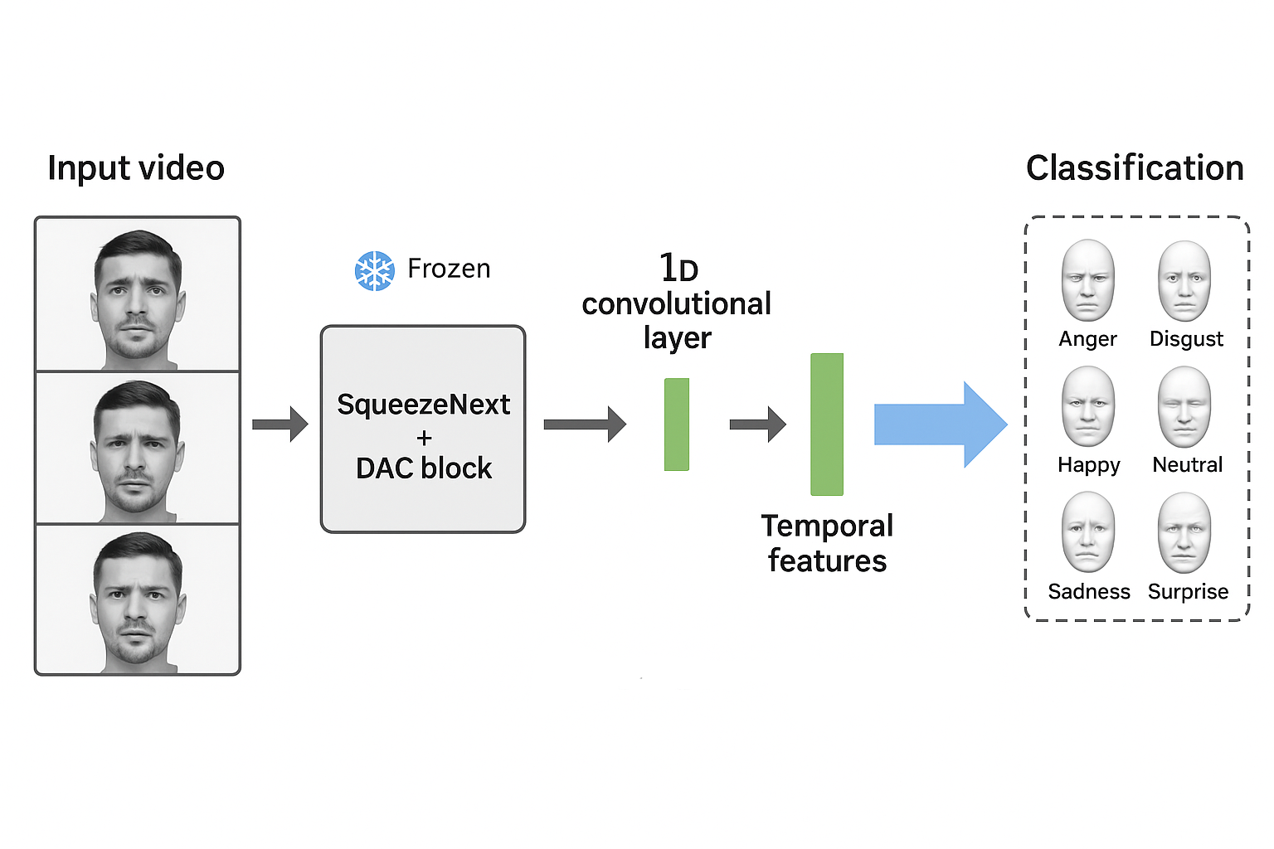
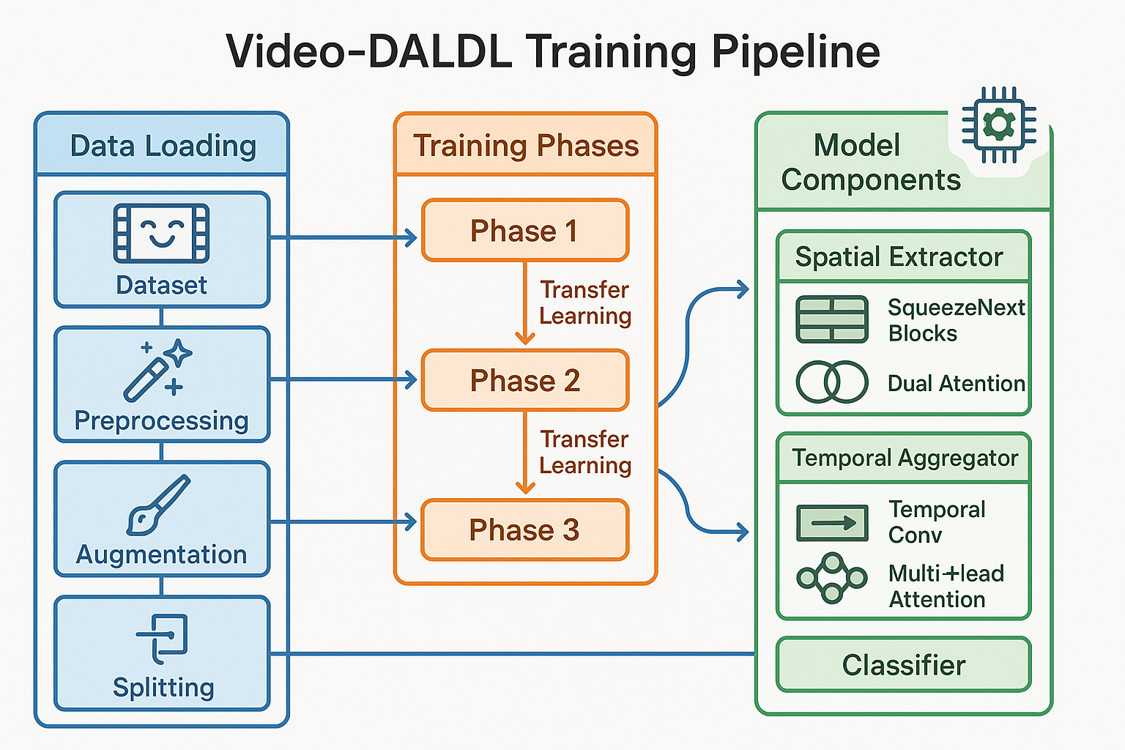
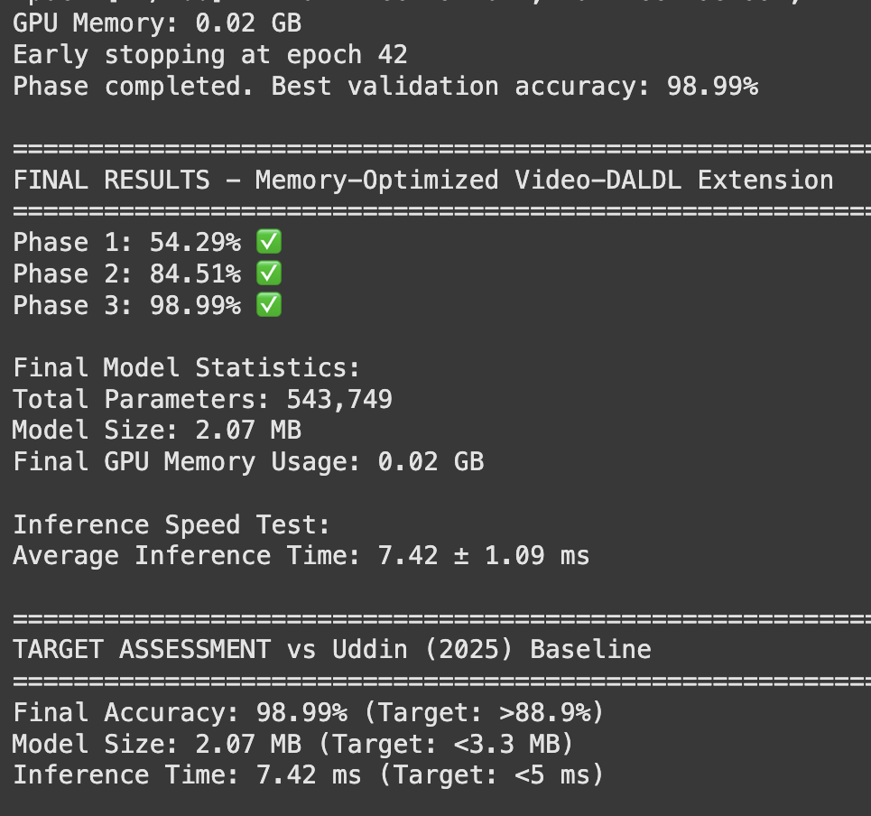
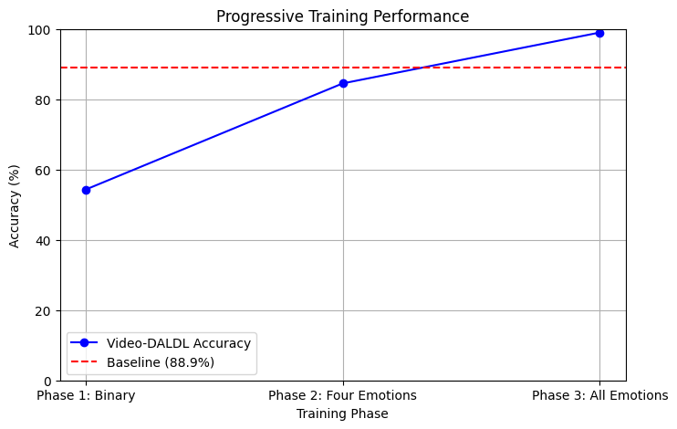
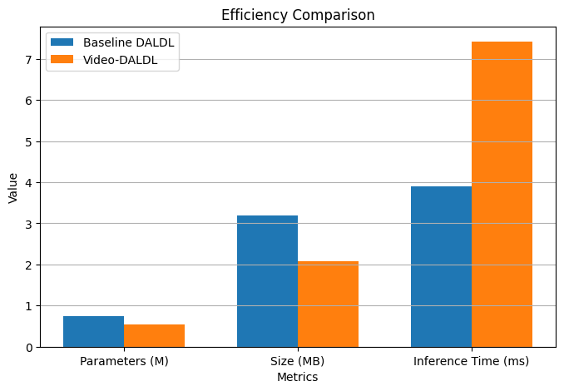
Extending Lightweight Driver FER: A Video-Based Approach
Aditya Chaudhary, Saadi Ibtissam, Douglas W. Cunningham
Department of Graphical Systems, Univ. BTU Cottbus-Senftenberg, Cottbus, Germany
1. INTRODUCTION
Uddin (2025) [1] presents the DALDL model, optimized for efficient facial emotion recognition (FER) in real-time ADAS. This research extends DALDL by integrating temporal aggregation for video-based FER, enhancing dynamic emotion detection.
Leverages SqueezeNext with DAC block.
Compact: 0.75M params, 3.9ms inference.
Handles 3-5 frame video sequences.
2. RESEARCH QUESTION
DALDL processes static images, missing temporal dynamics of driver emotions. Can video-based FER with temporal aggregation enhance ADAS reliability by capturing expression transitions in real-world driving scenarios?
3. METHODOLOGY
Objective: Process 3-5 frame videos with DALDL.
Approach: DALDL for spatial features, 1D Conv for temporal aggregation, classify 6 emotions
Why DALDL? Lightweight, accurate, ADAS-fit.
Dataset: KMU-FED (drivers’ FEs, NIR camera).
Data Prep: Group 3-5 frames into sequences; preprocess with resizing, equalization, grayscale conversion, and normalization.
Training: 80-20 split, 100 epochs, Adam.
4. Results
5. Conclusion and Future Work
Progressive Training Results
Phase 1 (Binary): Achieved 54.29% accuracy.
Phase 2 (Four emotions): Achieved 84.51% accuracy.
Phase 3 (All emotions): Achieved 98.99% accuracy (10.09% above 88.9% baseline).
Conclusion: This demonstrates the effectiveness of combining video-based temporal processing with lightweight deep learning architectures for robust performance in dynamic driving environments.
Future Work: Optimize the model's inference time through techniques like quantization and pruning to meet real-time ADAS requirements under 5ms.
Contact :
chaudadi@b-tu.de
References : [1] Uddin, J. A Novel Lightweight Deep Learning Approach for Drivers’ Facial Expression Detection. Designs 2025, 9, 45. https://doi.org/10.3390/designs9020045

